Slide 1
INTELLIGENT INVESTMENT ANALYSIS AND PREDICTION; USING MACHINE LEARNING.
Presented by: ONESMUS MUTHAMA
REG NO: COM/B/01-00154/2020
SUPERVISOR: Mr. Waliaro

Slide 2
Introduction
The project is a times series prediction that aims to revolutionize stock market analysis and investment decision-making.
By use of advanced machine learning techniques, I will develop a system capable of predicting market trends and assisting users in making informed investment choices.
Through the integration of Tiingo API for real-time stock data retrieval and LSTM (Long Short-Term Memory) networks for predictive modeling, our solution provides users with valuable insights into stock price movements.
With a interface powered by Streamlit, investors can visualize historical data, explore predictive analytics, and enhance their investment strategies.
Empowers users to navigate the complexities of the financial markets with confidence and precision, ultimately fostering smarter and more profitable investment decisions.

Slide 3
Problem statement
Despite the abundance of historical stock market data and advanced analytical techniques, investors and traders often struggle to accurately predict future market trends. Existing prediction tools may lack user-friendliness, reliability, or accessibility, hindering their effectiveness in supporting informed decision-making.
Therefore, there is a need for a comprehensive and user-friendly tool that leverages advanced data processing and predictive modeling techniques to provide accurate forecasts of stock market trends. This platform should offer intuitive visualization tools, real-time data integration, and actionable insights to empower investors and traders in making informed decisions and maximizing their investment returns.

Slide 4
Objectives
Main Objective
Develop a tool for predicting stock market trends and providing insights to assist investors and traders in making informed decisions.
Specific Objective
Design a user interface that allows users to input stock symbols, visualize historical data, and view predicted trends.
Develop predictive tool, using LSTM (Long Short-Term Memory) neural networks, to forecast stock prices accurately based on historical data.
Integrate the platform with Tiingo API to fetch real-time stock market data and ensure reliability of predictions.
Provide users with comprehensive insights, including trend charts, statistical summaries, and comparative analyses, to facilitate informed decision-making.
Optimize the tool's performance and scalability to handle large datasets and accommodate a growing user base effectively.
Incorporate features for user feedback to continuously enhance the tool's usability and effectiveness.

Slide 5
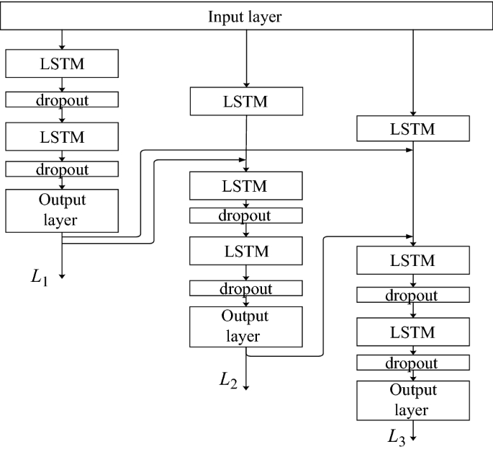
Algorithms Used
SEQUENTIAL
DENSE
LSTM
DROPOUT

Slide 6
Sequential Model: The Sequential model is a linear stack of layers used in deep learning models. In my project, it's utilized to create a neural network where layers are added sequentially, one after the other.
Dense Layer: Dense layers, also known as fully connected layers, are the most common type of layers used in neural networks. Each neuron in a dense layer is connected to every neuron in the previous layer. In my project, dense layers are added to the sequential model to process the input data and perform various computations.
LSTM (Long Short-Term Memory): LSTM is a type of recurrent neural network (RNN) architecture designed to capture long-term dependencies in sequential data. It is well-suited for time series prediction tasks, such as stock price forecasting, where past information is crucial for making predictions. In my project, LSTM layers are added to the sequential model to analyze the temporal patterns in historical stock market data and make predictions about future stock prices.
Dropout Layer: Dropout is a regularization technique used to prevent overfitting in neural networks. It works by randomly dropping a certain percentage of neurons during training, thereby reducing the model's reliance on specific features and improving its generalization ability. In my project, dropout layers are added to the sequential model to prevent overfitting and improve the robustness of the LSTM-based prediction model.

Slide 7
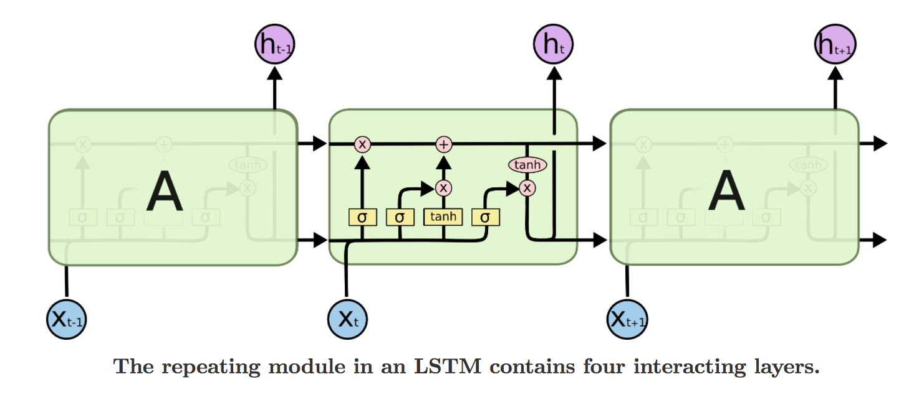
Creating a predictiion tool using RNN with LSTM
Long Short Term Memory is a RNN architecture which addresses the problem of training over long sequences and retaining memory.
Hidden layer of RNN with LSTM cell:
LSTM = Long short term memory

Slide 8
Requirement Analysis and Specification
Functional Requirements
User Authentication: The system shall allow users to register and log in securely. Users should be able to reset their passwords if forgotten.
Stock Data Retrieval: The system shall retrieve historical stock market data from Tiingo API for analysis. Users should be able to input the stock symbol of their choice for analysis and market trend prediction.
Data Analysis and Visualization: The system should perform data preprocessing and feature engineering to prepare the data for analysis.
Users should be able to visualize historical stock prices and trends using interactive charts and graphs. The system should calculate moving averages and other relevant indicators to aid in trend analysis.
Prediction tool: The system shall implement a machine learning algorithm, using LSTM, to predict future stock prices. Users should be able to input a desired stock symbols for forecasting.
Visualize Prediction results: The system should display the predicted stock prices alongside the actual prices for comparison. Users should be able to interpret prediction results and make informed investment decisions.

Slide 9
Requirement Analysis and Specification
Non-functional Requirements
Performance: The system shall respond to user inputs promptly, with minimal latency.
Security: User authentication and session management should be secure to prevent unauthorized access.
Reliability: The system should be reliable, with minimal downtime or errors.
It should handle unexpected inputs gracefully and provide informative error messages to users.
Scalability: The system should be scalable to accommodate a growing number of users and increasing data volumes.
Usability: The user interface should be intuitive and with clear navigation and instructions.
Compatibility: The system should be compatible with a wide range of devices and operating systems.
It should adapt to different screen sizes and resolutions for optimal viewing experience

Slide 10
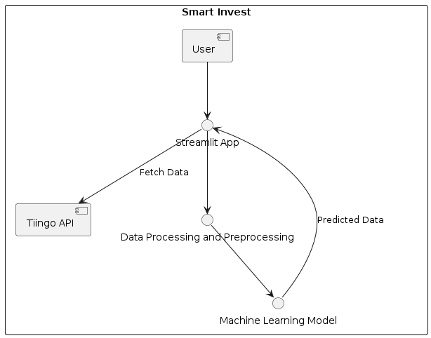
Software designs Architectural design

Slide 11
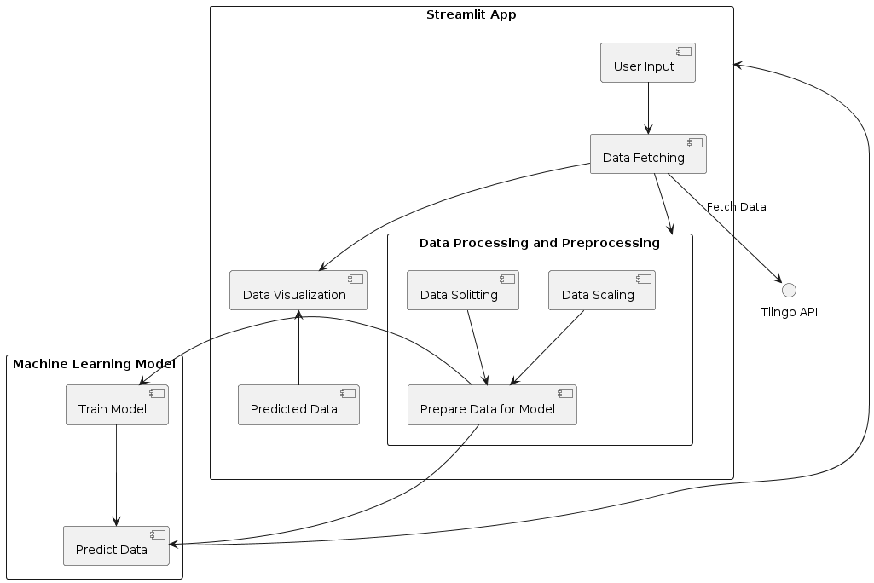
Detailed level design

Slide 12
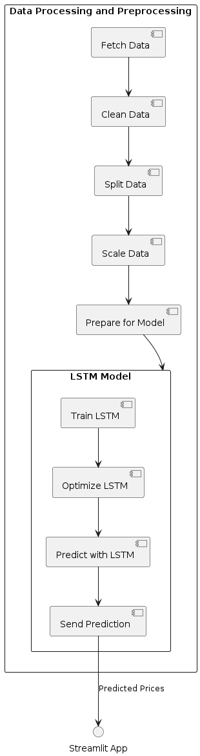
Detailed design

Slide 13
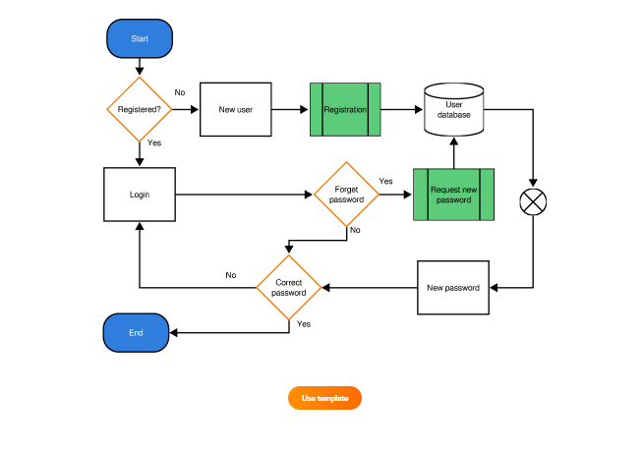
System models
User authentication dataflow diagram

Slide 14
System model Dataflow diagram
Preprocessing of data
Training-test split
Construction of predictive tool using lstm
Repository of stock data(Tiingo API)
Make prediction on stock data
Visualization of results

Slide 15
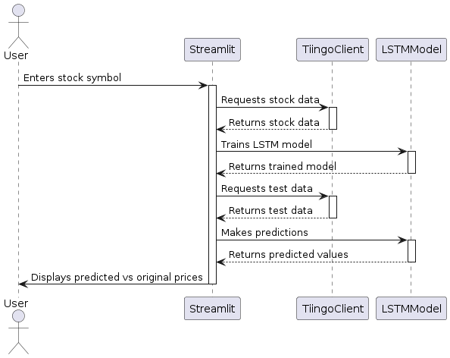
Sequence diagram

Slide 16
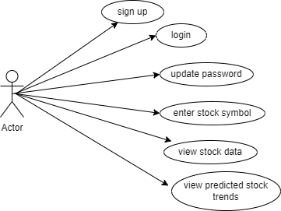
Use case diagram

Slide 17
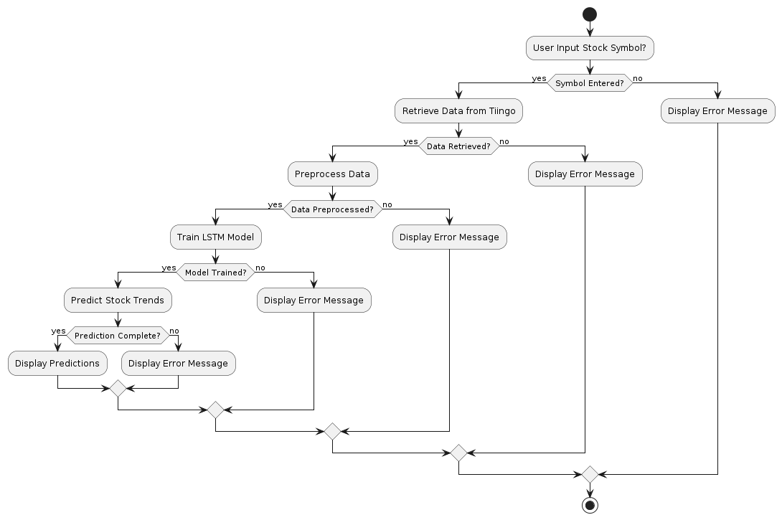
Activity diagram

Slide 18
Development environment
Hardware requirement: 4gb RAM, 500gb Hard Disk, 64-bit operating system (Windows), 2.5GHz core i5 processor.
Software requirement: Python 3.7 and above, Windows 10 Operating system and above, PyCharm IDE, Anaconda
Development Process design
Agile methodology:
Faster delivery
Flexible
Lower costs

Slide 19
Implementation process
Data Preprocessing using dataset
Visualization of Dataset
Feature Scaling
Preparing the Datasets for training
Reshaping the datasets
Implementation of sequential, dense, LSTM and dropout.
Preprocessing the Data
Predicting the Output
Result visualization

Slide 20
Development Budget
Requirement | Specification | Cost(KSH) | Availability
Hard disk | 500GB | 4000 | Available
Laptop | 4gb RAM, Core i5, 2.4 GHz | 25000 | Available

